Slide 1

DATA VISUALIZATION WITH COVID DATASET
A PROJECT REPORT
Submitted by,
THEJAS V- 20201ISE0054 VIKRAM - 20201ISE0055
SHREYAS S - 20201ISE0085
Under the guidance of,
Ms. POORNIMA S
in partial fulfillment for the award of the degree of
BACHELOR OF TECHNOLOGY
IN
INFORMATION SCIENCE AND ENGINEERING
At
PRESIDENCY UNIVERSITY BENGALURU
JANUARY 2024

Slide 2
TABLE OF CONTENTS
CHAPTER NO.
TITLE
PAGE NO.
1
Abstract
1
2
Objective
2
3
Methodology
3
4
Result
8
5
Conclusion
13

Slide 3
ABSTRACT
This report presents a detailed analysis of cyber crime statistics in India for the years 2018 and 2019, focusing on various categories of cyber crimes across different states. Using statewise data, we performed comprehensive data cleaning, exploratory data analysis (EDA), and visualization to uncover trends, patterns, and insights. The findings highlight that fraud and extortion are the most common types of cyber crimes, while some states experience significantly higher crime rates than others. The analysis also reveals both declines and increases in specific crime categories over the two years, with concerning trends in areas such as sexual exploitation and terrorism-related activities. This study underscores the need for targeted policy measures, awareness programs, and technological advancements to effectively address and mitigate the impact of cyber crime in India.
1
School of Computer Science Engineering & Information Science, Presidency University.

Slide 4
OBJECTIVE
The increasing complexity and volume of cyber threats pose significant challenges to cybersecurity professionals. Traditional methods of analyzing security data often fall short in detecting and responding to evolving threats in real-time. This project addresses the need for effective data visualization tools to enhance threat intelligence, improve situational awareness, and facilitate proactive defense measures against cyber attacks.
2
School of Computer Science Engineering & Information Science, Presidency University.

Slide 5
METHODOLOGY
Data Collection
Sources: The data for this analysis was sourced from reliable and authoritative databases, specifically focusing on cyber crime statistics for India for the years 2018 and 2019. Government databases, official cyber crime reports, and credible research publications were utilized to ensure the accuracy and completeness of the data.
Scope: The dataset includes columns representing different cities and various categories of cyber crimes, such as Personal Revenge, Anger, Fraud, Extortion, and more, along with metrics like Total crimes and Crime Rate.
Data Cleaning
Missing Values: Missing data were addressed by either imputing values using statistical methods (e.g., mean or median imputation) or by removing incomplete records to maintain dataset integrity.
3
School of Computer Science Engineering & Information Science, Presidency University.

Slide 6
Error Correction: Data entries were scrutinized for errors, such as duplicate records, incorrect categorizations, or out-of-range values. Identified errors were corrected through cross-verification with source data.
Consistency: Ensured consistency in data formatting, units, and column names to facilitate seamless integration and analysis. This involved standardizing categorical variables and normalizing numerical values where necessary.
Data Preparation
Normalization: Data normalization techniques were applied to ensure that all variables are on a comparable scale, particularly for numerical fields. This step is crucial for accurate statistical analysis and visualization.
Feature Engineering: Additional features were derived from existing data to enrich the analysis. For example, crime rates per capita were calculated for more insightful comparisons across different states and cities.
4
School of Computer Science Engineering & Information Science, Presidency University.

Slide 7
Error Correction: Data entries were scrutinized for errors, such as duplicate records, incorrect categorizations, or out-of-range values. Identified errors were corrected through cross-verification with source data.
Consistency: Ensured consistency in data formatting, units, and column names to facilitate seamless integration and analysis. This involved standardizing categorical variables and normalizing numerical values where necessary.
Data Preparation
Normalization: Data normalization techniques were applied to ensure that all variables are on a comparable scale, particularly for numerical fields. This step is crucial for accurate statistical analysis and visualization.
Feature Engineering: Additional features were derived from existing data to enrich the analysis. For example, crime rates per capita were calculated for more insightful comparisons across different states and cities.
5
School of Computer Science Engineering & Information Science, Presidency University.

Slide 8
Exploratory Data Analysis (EDA)
Descriptive Statistics: Basic statistical measures (mean, median, standard deviation, etc.) were computed to summarize the central tendencies and dispersion of the data.
Visual Exploration: Initial visualizations, such as histograms, box plots, and scatter plots, were created to explore the distribution of data and identify any apparent trends or anomalies.
Comparative Analysis: Year-over-year comparisons were made between 2018 and 2019 to identify trends in different types of cyber crimes. This included the use of bar charts and line graphs.
Data Visualization
Category Distribution: Pie charts and bar graphs were used to represent the distribution of different types of cyber crimes. This helps in understanding which crimes are most prevalent.
6
School of Computer Science Engineering & Information Science, Presidency University.

Slide 9
Trend Analysis: Line graphs were used to track changes in crime rates over the two years, identifying increasing or decreasing trends.
Correlation Analysis: Heatmaps were created to examine correlations between various crime categories, revealing potential relationships and patterns.
Reporting
Summary of Findings: Key findings from the analysis were summarized, focusing on the most significant trends and insights. This includes the identification of the most common types of cyber crimes and regions with the highest crime rates.
Presentation Preparation: Findings were organized into a coherent narrative for presentation, with supporting visuals and clear, concise explanations to communicate the results effectively.
7
School of Computer Science Engineering & Information Science, Presidency University.

Slide 10
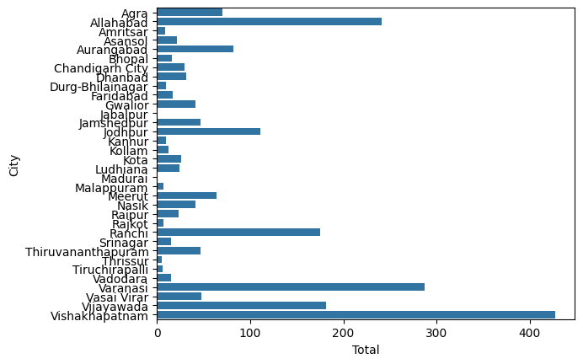
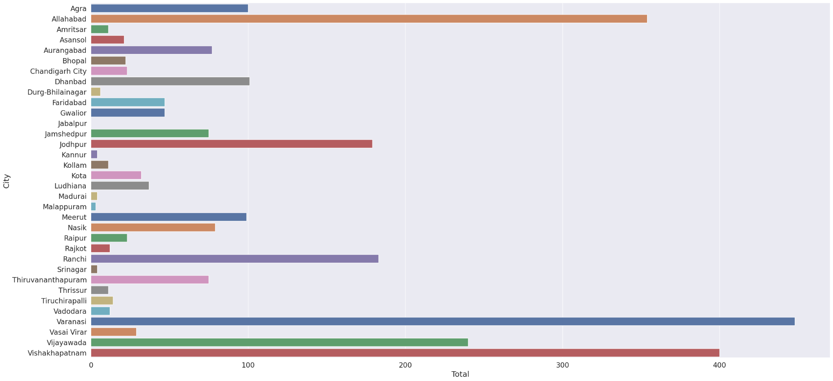
RESULTS
The following are the data visualizations derived from our dataset:
The above graph shows the total number of cybercrimes in each city in 2018.
The above graph shows the total number of cybercrimes in each city in 2019.
8
School of Computer Science Engineering & Information Science, Presidency University.

Slide 11
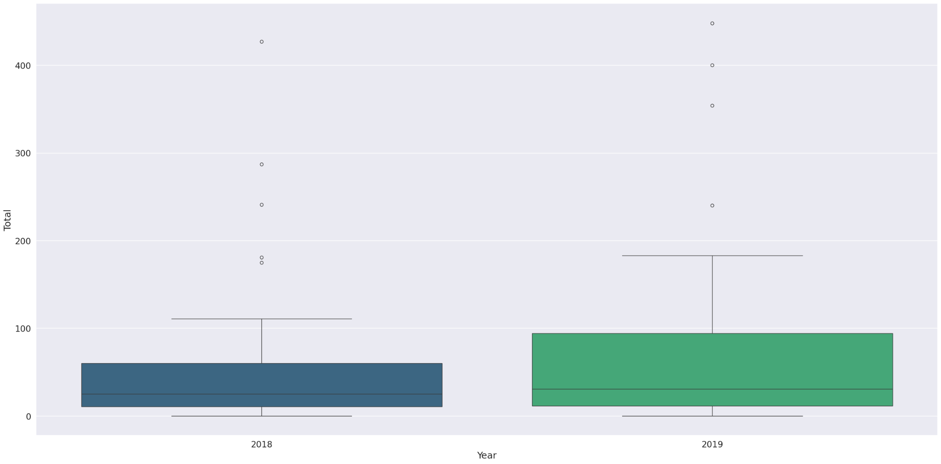
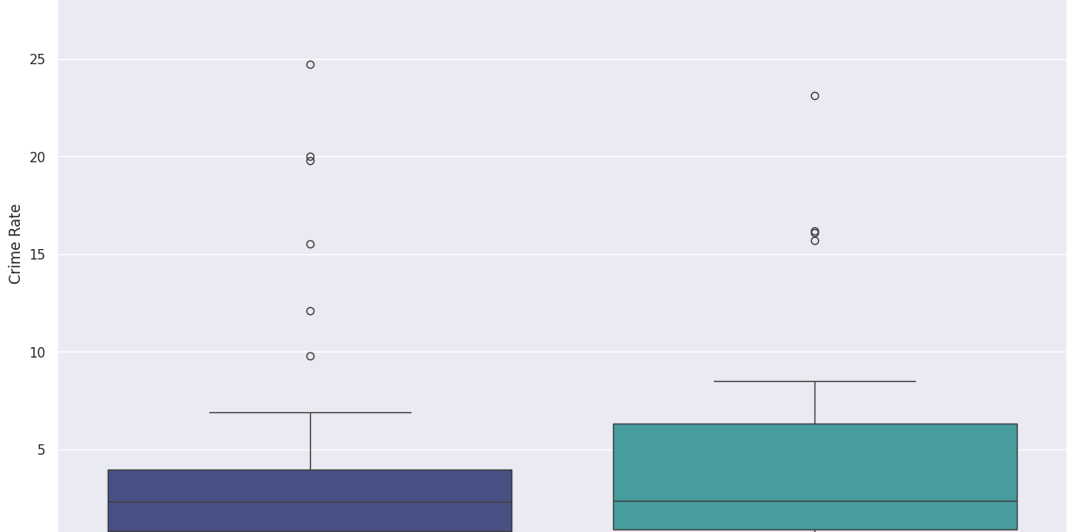
The above graph shows the distribution of total cybercrimes and crime rates across 2018 and 2019.
Shows the distribution of crime rates across 2018 and 2019.
9
School of Computer Science Engineering & Information Science, Presidency University.

Slide 12
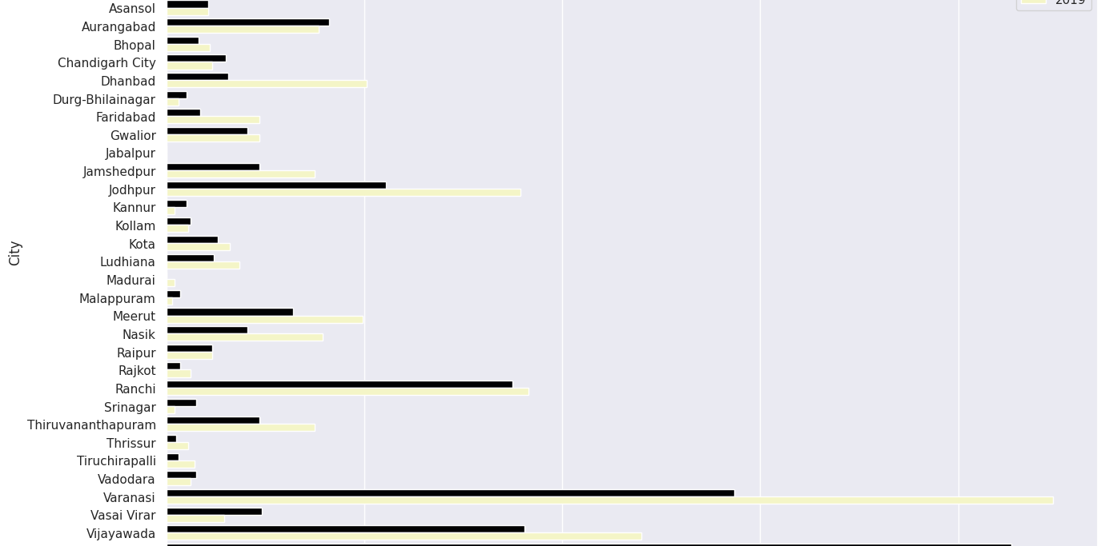
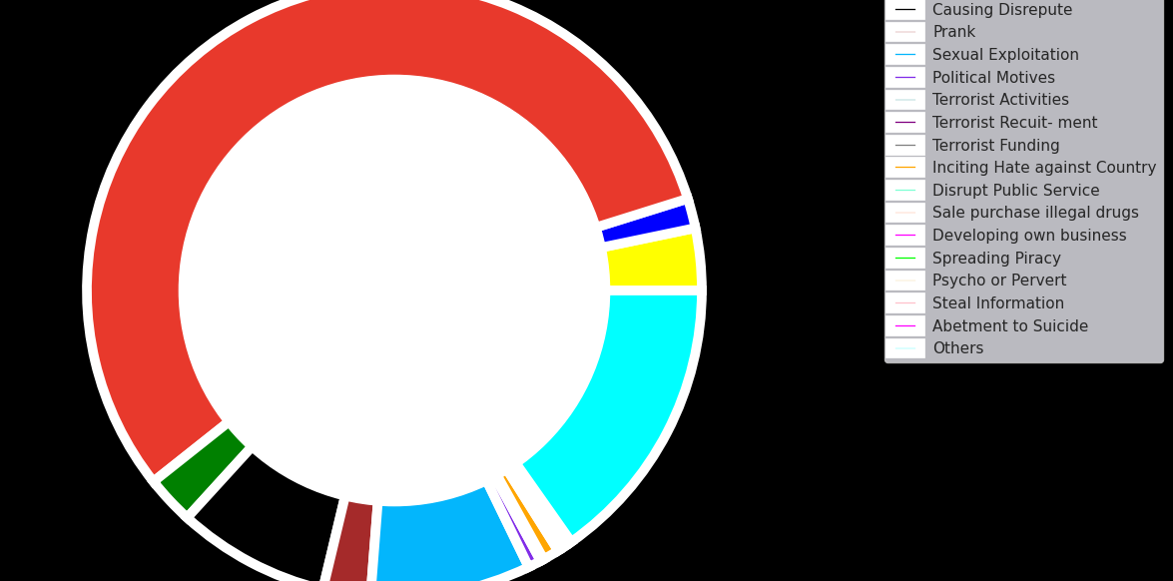
Shows the number of cybercrimes for each motivation in 2018.
Shows the number of cybercrimes for each motivation in 2019.
10
School of Computer Science Engineering & Information Science, Presidency University.

Slide 13
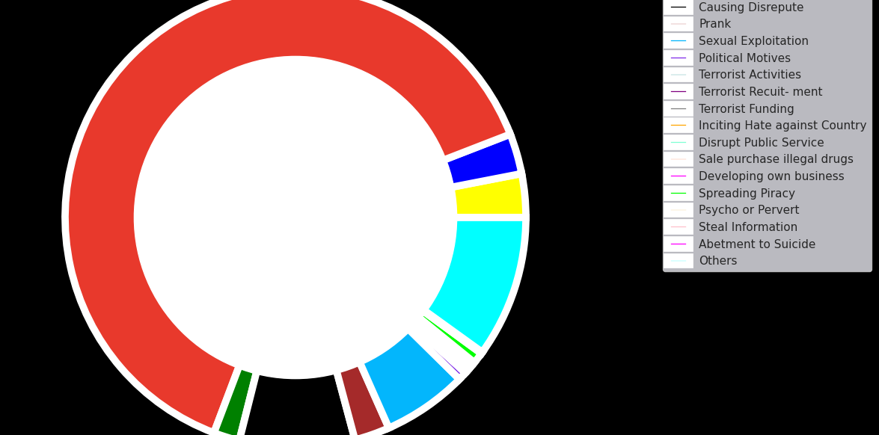
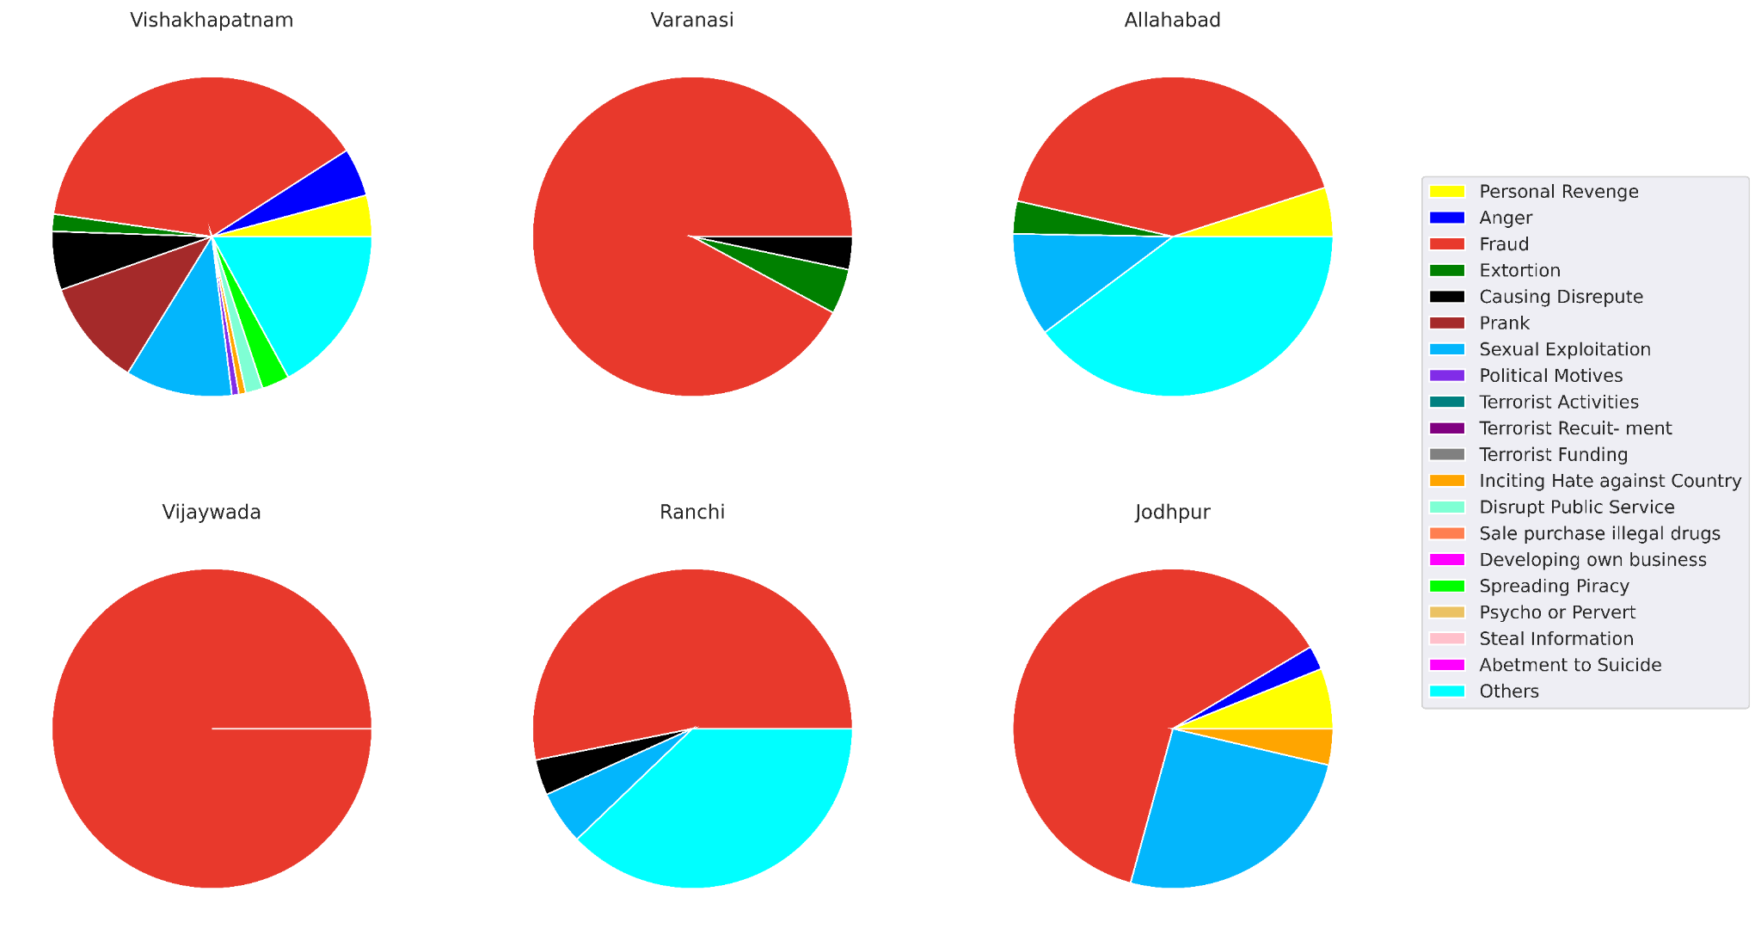
Shows the number of cybercrimes for each motivation in 2019.
Shows the distribution of cybercrime motivations in Vishakhapatnam in 2018.
11
School of Computer Science Engineering & Information Science, Presidency University.

Slide 14
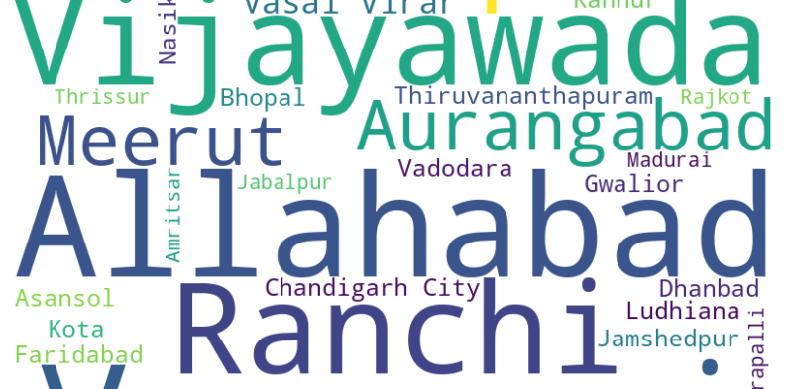
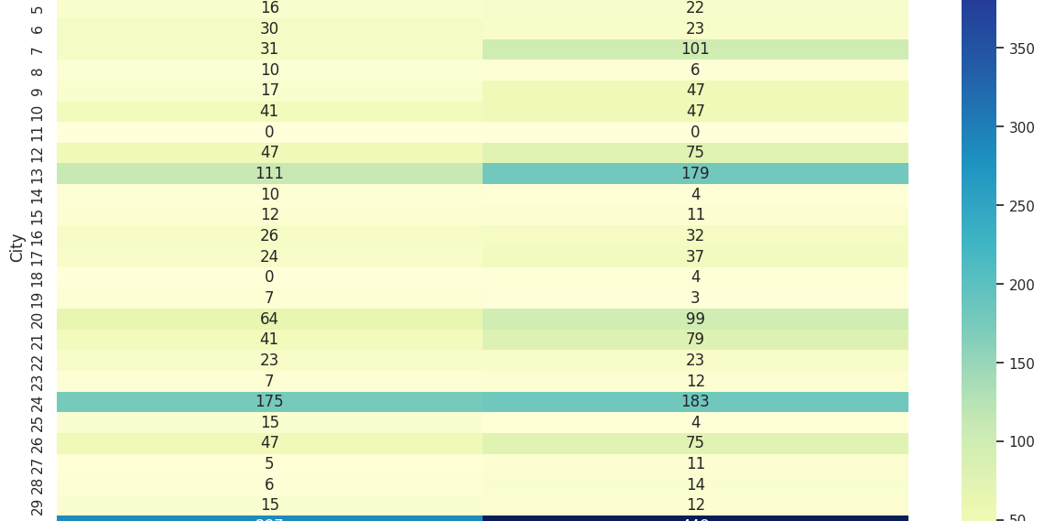
Shows a word cloud visualizing the cities with highest crime rates.
Shows the distribution of cybercrime in the form of a heatmap across indian cities.
12
School of Computer Science Engineering & Information Science, Presidency University.

Slide 15
CONCLUSION
The analysis of cyber crime data from 2018 and 2019 reveals significant trends and insights into the state of cyber crime in India. Notably, fraud and extortion emerged as the most prevalent categories, indicating a need for stronger preventive measures. The data also highlighted certain states with disproportionately high crime rates, suggesting targeted regional interventions are necessary. Over the two years, while some crime categories showed a decline, others, such as sexual exploitation and terrorism-related activities, unfortunately exhibited an upward trend. These findings underscore the importance of continuous monitoring and adaptive strategies to combat the evolving landscape of cyber crime effectively.
Furthermore, the geographical analysis of cyber crime rates revealed that urban areas, particularly those with higher internet penetration and digital transactions, experienced higher incidences of cyber crimes. This points to the need for increased cybersecurity awareness and robust digital infrastructure to protect sensitive information and prevent cyber attacks.
13
School of Computer Science Engineering & Information Science, Presidency University.

Slide 16
The correlation analysis demonstrated that certain types of cyber crimes, such as those driven by financial motives, are often interconnected. This suggests that addressing one type of cyber crime could potentially reduce the occurrence of others. Implementing comprehensive cybersecurity policies that address multiple facets of cyber crime could therefore be highly effective.
In light of these findings, several recommendations can be made:
Policy Implementation: Governments should enforce stricter regulations and enhance legal frameworks to deter cyber criminals. This includes updating existing cyber laws and introducing new legislations tailored to emerging cyber threats.
Awareness Programs: Public awareness campaigns should be launched to educate citizens about the risks of cyber crime and ways to protect themselves online. Special focus should be given to high-risk areas identified in the analysis.
14
School of Computer Science Engineering & Information Science, Presidency University.

Slide 17
Technological Enhancements: Investments in advanced cybersecurity technologies, such as AI-driven threat detection systems and blockchain for secure transactions, should be prioritized. Organizations should also regularly update their security protocols to counteract evolving cyber threats.
Collaboration and Intelligence Sharing: Enhanced cooperation between law enforcement agencies, private sector, and international bodies is crucial. Sharing intelligence and best practices can help in anticipating and mitigating cyber threats more effectively.
Research and Development: Continued research into cyber crime trends and the development of new cybersecurity measures are essential. Supporting academic and industrial research initiatives can lead to innovative solutions to combat cyber crime.
In conclusion, the dynamic nature of cyber crime necessitates a proactive and multi-faceted approach. By implementing targeted interventions, enhancing public awareness, and leveraging advanced technologies, India can strengthen its defenses against cyber threats and create a safer digital environment for its citizens.
15
School of Computer Science Engineering & Information Science, Presidency University.

